Slide 1
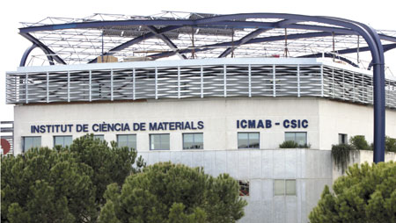
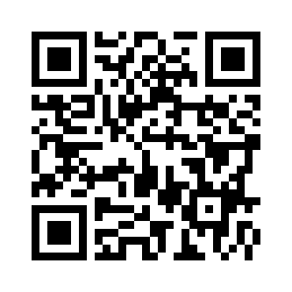


Scientific School on Materials for Biomedical Applications (MATBIO2017)
19th-22th June 2017 at ICMAB, Campus UAB (Barcelona)
Scope of the Workshop
Venue
Accommodation
The summer school “Materials for Biomedical Applications” is addressed to last year undergraduate, master and PhD students, who are interested in the development of materials with biomedical applications. The aim of the summer school is to present the design, development and application of new materials for a wide range of biomedical applications. The school includes lectures from international and local scientist, Hands on and management activities. As a consequence, this Scientific School is an optimal opportunity to discover, learn and practise on material science focusing on fundamental science and applied research in the field of biomedicine. The school is included in the Severo Ochoa activities.
Intitut de Ciència de Materials de Barcelona (ICMAB)
Universitat Autònoma de Barcelona, Campus UAB, 08193-Bellaterra, Barcelona (SPAIN).
Local organizers:
Dr. Arantzazu Gonzalez Dr. Anna Laromaine
Dr. Rosario Núñez Dr. Jose Vidal
Dr. Gerard Tobias
The organization highly recommends the Hotel Campus UAB for ideal location and convenience. We have booked some rooms at the hotel, at 65€ individual room and 72 € for a double room, breakfast included. Tourist tax is not included in the price (0.5 €/day)
Reservation must be made by the participant themselves at until xx/xx/2017, sending an email to jrecepcion@hotelcampusuab.com indicating MATBIO 2017 in the subject.
Registration fees
For all the participants: 100 €
Registration fee covers the conference material, lunches and coffee breaks.
Information: congresses.icmab.es/xxxxx
matbio2017@icmab.es
Deadline for registration: xxx^{th}xxxx 2017.
Notification of acceptance : xxx^{h} xxxx2017.
Main Topics
Biosensors
Drug delivery: carriers
Imaging/diagnosis
Tissue Regeneration
Bioengineering Scaffolds
Therapy
Materials cycle
----------------------------------------------------------------------
The scientific programme includes lectures, Hands On management activities.
http://
----------------------------------------------------------------------
Severo Ochoa Program (MINECO, SEV- 2015-0496)

